Slide 1
Computer Science
Binary Search Tree
Samuel Lukas

Slide 2
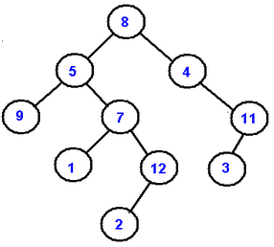
Binary Tree
A binary tree is made of nodes, where each node contains a "left" reference, a "right" reference, and a data element. The topmost node in the tree is called the root. Every node (excluding a root) in a tree is connected by a directed edge from exactly one other node. This node is called a parent. On the other hand, each node can be connected to arbitrary number of nodes, called children. Nodes with no children are called leaves, or external nodes. Nodes which are not leaves are called internal nodes. Nodes with the same parent are called siblings.

Slide 3
Traversals
A traversal is a process that visits all the nodes in the tree. Since a tree is a nonlinear data structure, there is no unique traversal.
depth-first traversal
PreOrder traversal : visit the parent first and then left and right children;
InOrder traversal : visit the left child, then the parent and the right child;
PostOrder traversal : visit left child, then the right child and then the parent;
breadth-first traversal
Level order traversal : visits nodes by levels from top to bottom and from left to right.

Slide 4
Traversal (cont)
PreOrder
8, 5, 9, 7, 1, 12, 2, 4, 11, 3
InOrder
9, 5, 1, 7, 2, 12, 8, 4, 3, 11
PostOrder
9, 1, 2, 12, 7, 5, 3, 11, 4, 8
LevelOrder
8, 5, 4, 9, 7, 11, 1, 12, 3, 2

Slide 5
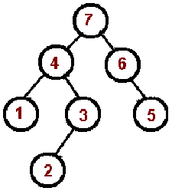
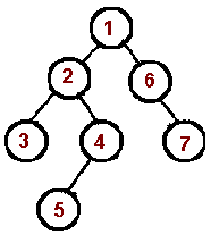
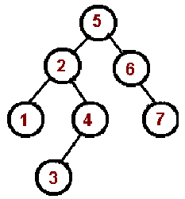
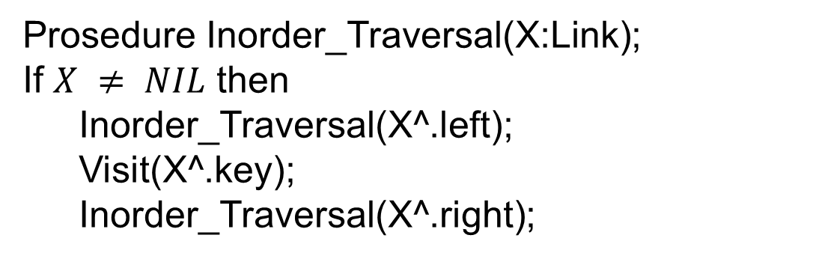
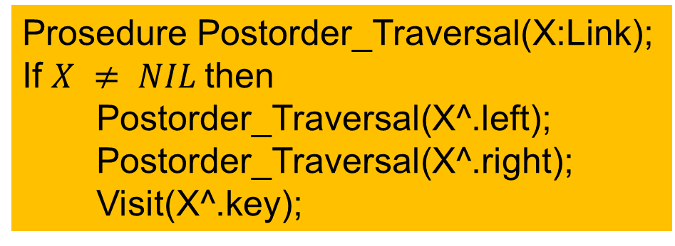
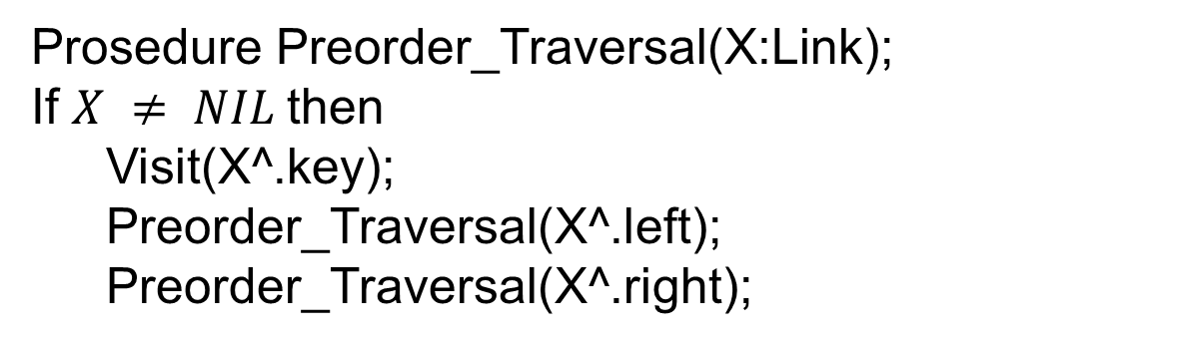
Traversal (cont)
Prosedure Preorder_Traversal(X:Link);
If $X ≠ NIL$then
Visit(X^.key);
Preorder_Traversal(X^.left);
Preorder_Traversal(X^.right);
Prosedure Postorder_Traversal(X:Link);
If $X ≠ NIL$then
Postorder_Traversal(X^.left);
Postorder_Traversal(X^.right);
Visit(X^.key);
Prosedure Inorder_Traversal(X:Link);
If $X ≠ NIL$ then
Inorder_Traversal(X^.left);
Visit(X^.key);
Inorder_Traversal(X^.right);

Slide 6
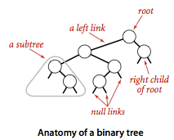
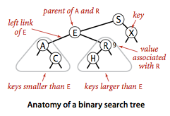
Binary Search Tree
A binary search tree (BST) is a binary tree where each node has a Comparable key (and an associated value) and satisfies the restriction that the key in any node is larger than the keys in all nodes in that node's left subtree and smaller than the keys in all nodes in that node's right subtree.

Slide 7

Characteristics of Binary Search Tree
$X$ is a node of BST, $Y$ is a node at left subtree $X$ then $key(Y)≤key(X),$but if $Y$ is a node in right subtree $X$ then $key\left(Y\right)≥key\left(X\right).$
Create 2 BST of A = {2,3,5,5,7,8}
5
3
3
7
2
7
5
8
2
5
8
5

Slide 8
Exersice 01
Create five BST of A = {1,4,5,10,16,17,21} with height from 2 to 6

Slide 9
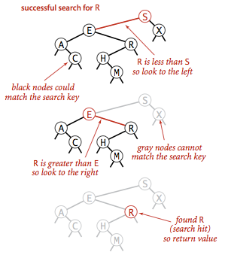
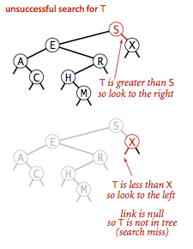
Searching Binary Search Tree
Function Tree_Search(V:integer, X:link) : link;
Begin
If X = Nil Then Tree_Search := Nil
else
If V=X.key Then Tree_Search := X
else
If V<X.key Then Tree_Search(X.left)
else
Tree_Search(X.right)
End;

Slide 10
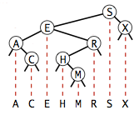
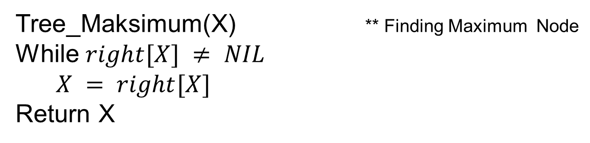
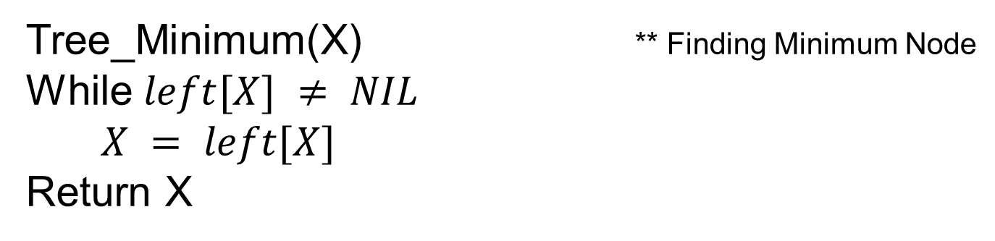
Minimum and Maximum Value
How to find minimum and maximum node of a Binary Search Tree ?
Tree_Minimum(X) ** Finding Minimum Node
While $left[X] ≠ NIL$
$X = left[X]$
Return X
Tree_Maksimum(X) ** Finding Maximum Node
While $right[X] ≠ NIL$
$X = right[X]$
Return X

Slide 11
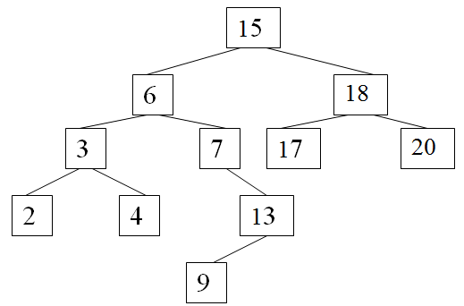
Successor of X
From this BST find the successor of 15 and 13
Successor of 15 is 17
Successor of 13 is 15

Slide 12
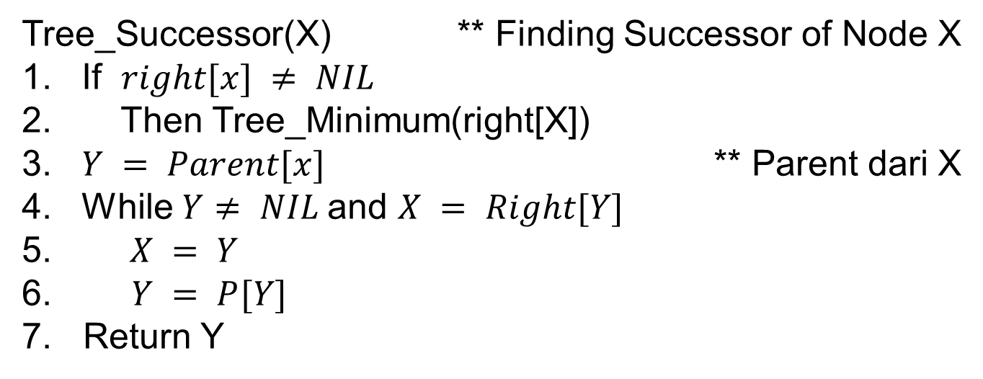
Successor of X
Knowing the value of node X, what value is the X’successor
Tree_Successor(X) ** Finding Successor of Node X
1. If $right[x] ≠ NIL$
2. Then Tree_Minimum(right[X])
3. $Y = Parent[x]$ ** Parent dari X
4. While $Y≠ NIL$and $X = Right[Y]$
5. $X = Y$
6. $Y = P[Y]$
7. Return Y

Slide 13
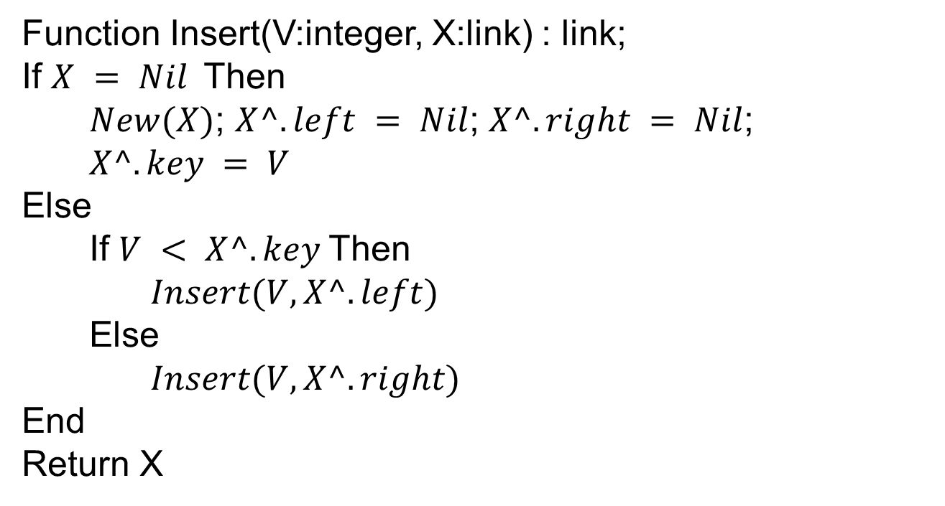
Insert a node in BST
Function Insert(V:integer, X:link) : link;
If $X = Nil$Then
$New(X)$; $X^.left = Nil$; $X^.right = Nil$;
$X^.key = V$
Else
If $V < X^.key$Then
$Insert(V,X^.left)$
Else
$Insert(V,X^.right)$
End
Return X

Slide 14
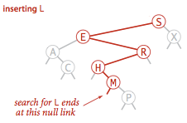
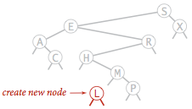
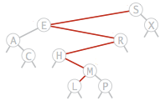
Insert a node in BST (cont)

Slide 15
Exercise 02
Create a BST with the given sequence :
{2,1,4,3} {2,1,3,4} {1,4,3,2} {1,4,2,3} {1,3,2,4}
{2,4,1,3} {1,3,4,2} {2,3,1,4} {1,2,4,3} {1,2,3,4}
{2,4,3,1} {2,3,4,1} {4,3,2,1} {4,3,1,2} {4,2,1,3}
{4,1,3,2} {4,1,2,3} {3,2,1,4} {3,1,2,4} {3,4,1,2}
{4,2,3,1} {3,2,4,1} {3,1,4,2} {3,4,2,1}

Slide 16
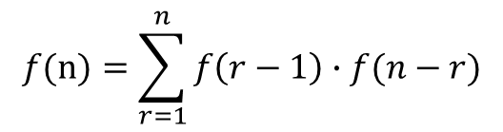
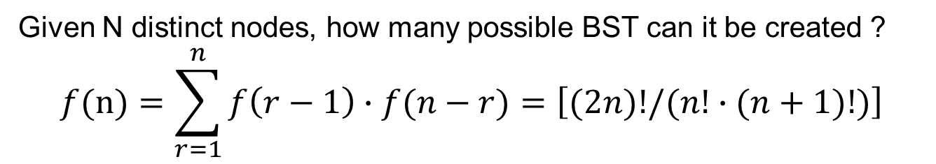
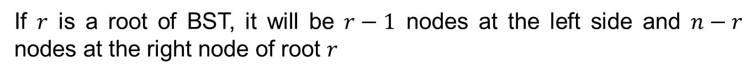
Number of BST of n distinct nodes
Given N distinct nodes, how many possible BST can it be created ?
$$f(n)=\sum_{r=1}^{n}{f\left(r−1\right)∙f(n−r)}=\left[(2n)!/(n!∙(n+1)!)\right]$$
$f\left(n\right)$ is number of trees with $n$ distinct nodes
If $r$ is a root of BST, it will be $r−1$ nodes at the left side and $n−r$ nodes at the right node of root $r$
Then total BST can be made if $r$ is the root of BST is $f(r−1)∙f(n−r)$
$$f(n)=\sum_{r=1}^{n}{f\left(r−1\right)∙f(n−r)}$$
The $r$ could be $1,2,…n$ then

Slide 17
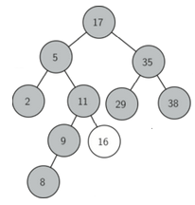
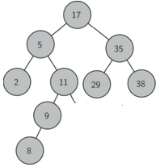
Deleting a node at BST
Deleting Node leaf 16

Slide 18
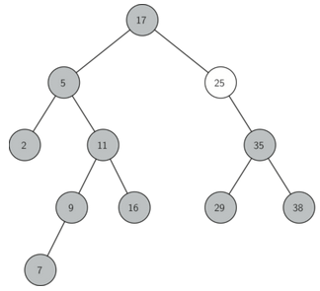
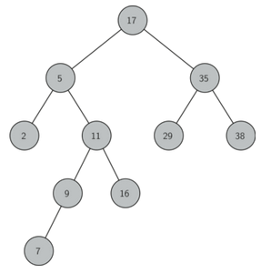
Deleting a node at BST
Deleting Node 25 has one child

Slide 19
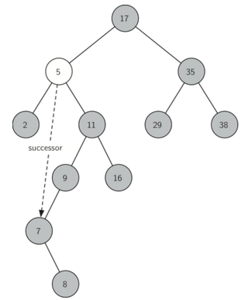
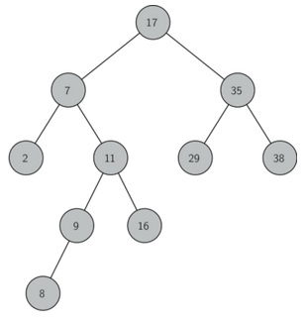
Deleting Node 5 has two childs

Slide 20
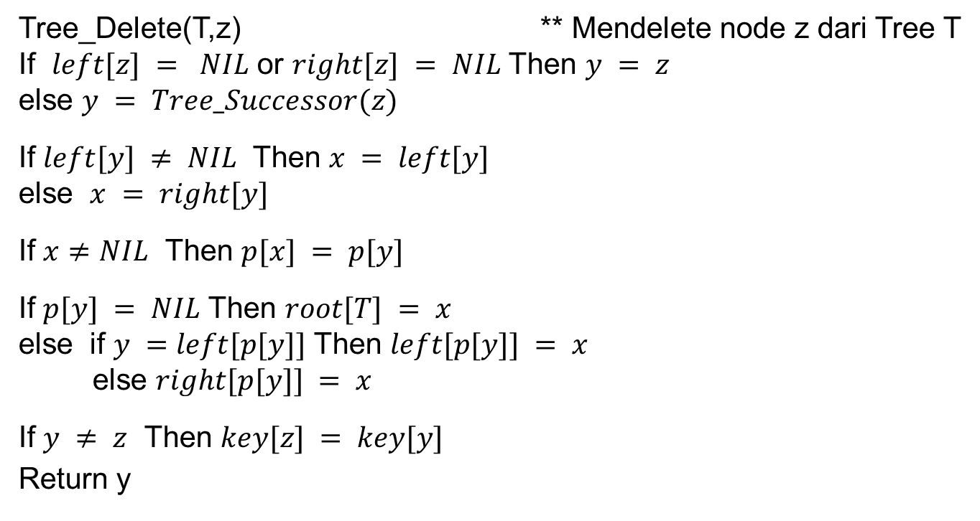
Deleting a node at BST
Tree_Delete(T,z) ** Mendelete node z dari Tree T
If $left[z] = NIL$ or $right[z] = NIL$ Then $y = z$
else $y = Tree_Successor(z)$
If $left[y] ≠ NIL$ Then $x = left[y]$
else $x = right[y]$
If $x≠NIL$ Then $p[x] = p[y]$
If $p[y] = NIL$ Then $root[T] = x$
else if $y =left[p[y]]$ Then $left[p[y]] = x$
else $right[p[y]] = x$
If $y ≠ z$ Then $key[z] = key[y]$
Return y

Slide 21
Exercise 03
Create a BST with this sequence
{15,5,3,12,10,6,7,13,16,20,18,23}
Restructure the BST if one of this node is deleted
13
16
6

Slide 22
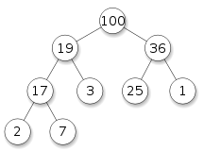
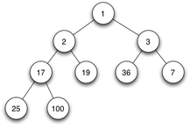
Heap Tree
A binary heap can be seen as a binary tree with two additional constraints:
Shape property
A binary heap is a complete binary tree; that is, all levels of the tree, except possibly the last one (deepest) are fully filled, and, if the last level of the tree is not complete, the nodes of that level are filled from left to right.
Heap property
All nodes are either greater than or equal to or less than or equal to each of its children, according to a comparison predicate defined for the heap.

Slide 23
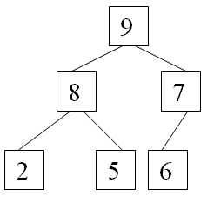
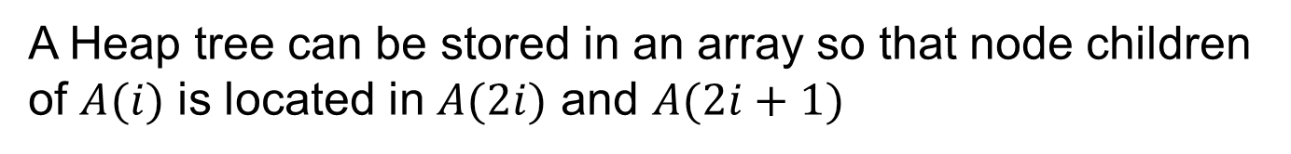
Heap Tree and Array
A Heap tree can be stored in an array so that node children of $A(i)$ is located in $A(2i)$ and $A(2i+1)$
Index | 1 | 2 | 3 | 4 | 5 | 6
Label | 9 | 8 | 7 | 2 | 5 | 6

Slide 24
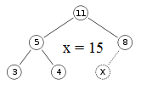

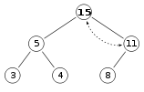
Insert a Node in Heap Tree
To add an element to a heap we must perform an up-heap operation (also known as bubble-up, percolate-up, sift-up, trickle-up, heapify-up, or cascade-up), by following this algorithm:
Add the element to the bottom level of the heap.
Compare the added element with its parent; if they are in the correct order, stop.
If not, swap the element with its parent and return to the previous step.

Slide 25

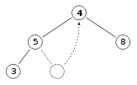

Deleting Root in Heap Tree
It is also called down-heap (also known as bubble-down, percolate-down, sift-down, trickle down, heapify-down, cascade-down and extract-min/max).
Replace the root of the heap with the last element on the last level.
Compare the new root with its children; if they are in the correct order, stop.
If not, swap the element with one of its children and return to the previous step. (Swap with its smaller child in a min-heap and its larger child in a max-heap.)

Slide 26

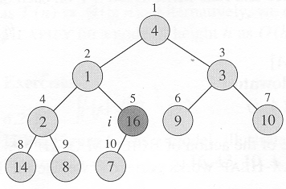
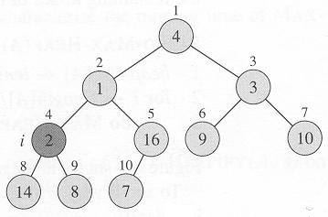
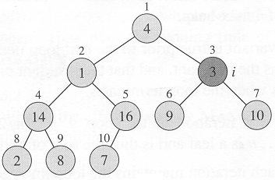
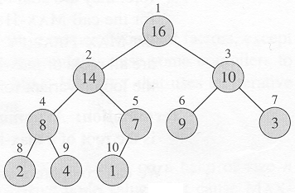
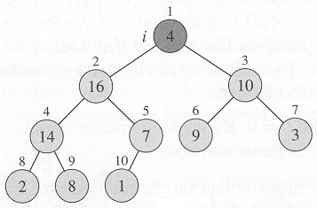
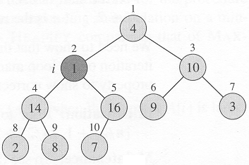
Building Heap Tree
Given an array A, make a Heap Tree
Build complete binary Tree
consider the gray node

Slide 27
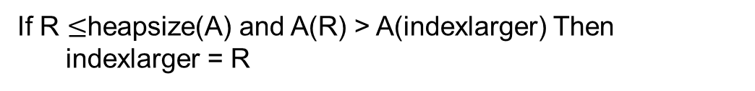
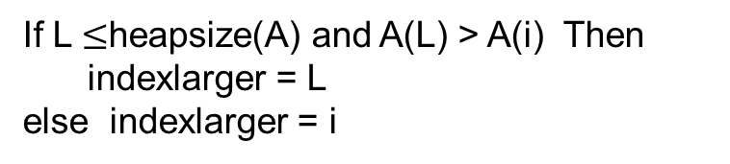
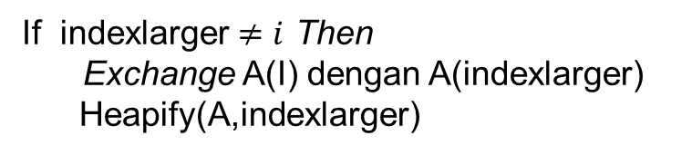
Building A Heap Tree Algorithm
Heapsize(A) = length(A)
For i = length(A)/2 down to 1
Do Heapify(A,i)
Given an array A, make a Heap Tree
Heapify(A,i)
L = left(i) = 2i \\ index array of left child
R =right(i) = 2i+1 \\ index array of right child
If L $≤$heapsize(A) and A(L) > A(i) Then
indexlarger = L
else indexlarger = i
If R $≤$heapsize(A) and A(R) > A(indexlarger) Then
indexlarger = R
If indexlarger $≠i$ Then
Exchange A(I) dengan A(indexlarger)
Heapify(A,indexlarger)

Slide 28
Exercise 04
Building heap tree with this data
Index | 1 | 2 | 3 | 4 | 5 | 6 | 7 | 8 | 9 | 10
Label | 16 | 4 | 10 | 14 | 7 | 9 | 3 | 2 | 8 | 1
Index | 1 | 2 | 3 | 4 | 5 | 6 | 7 | 8 | 9 | 10 | 11 | 12 | 13 | 14
Label | 27 | 17 | 3 | 16 | 13 | 10 | 1 | 5 | 7 | 12 | 4 | 8 | 9 | 0

Slide 29


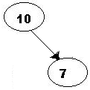
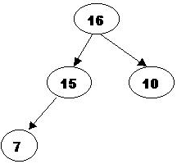

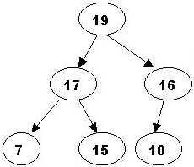






Heapsort Algorithm
Algoritma Heapsort
Build_Heap(A)
For i = length[a] down to 2
Exchange A[1] with A[i]
Heapsize(A) = Heapsize(a) – 1
Heapify(A,1)
Construct Heap Tree
Deleting root
reconstruct Heap tree without the root
Repeat until the last root

Slide 30
Exercise 05
Does the Heap Sort with these data
Index | 1 | 2 | 3 | 4 | 5 | 6 | 7 | 8 | 9 | 10
Label | 16 | 14 | 10 | 8 | 7 | 9 | 3 | 2 | 4 | 1
Index | 1 | 2 | 3 | 4 | 5 | 6 | 7 | 8 | 9
Label | 5 | 13 | 2 | 25 | 7 | 17 | 20 | 8 | 4

